Slide 1
Project Design
Daphne Williams
Shane Trentham

Slide 2
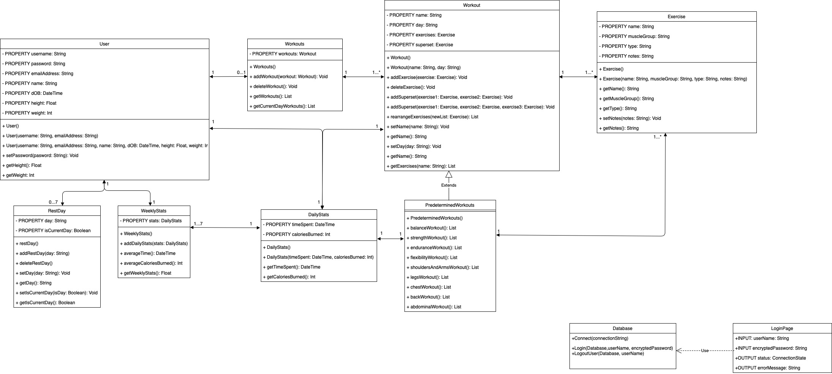
Class Diagram

Slide 3
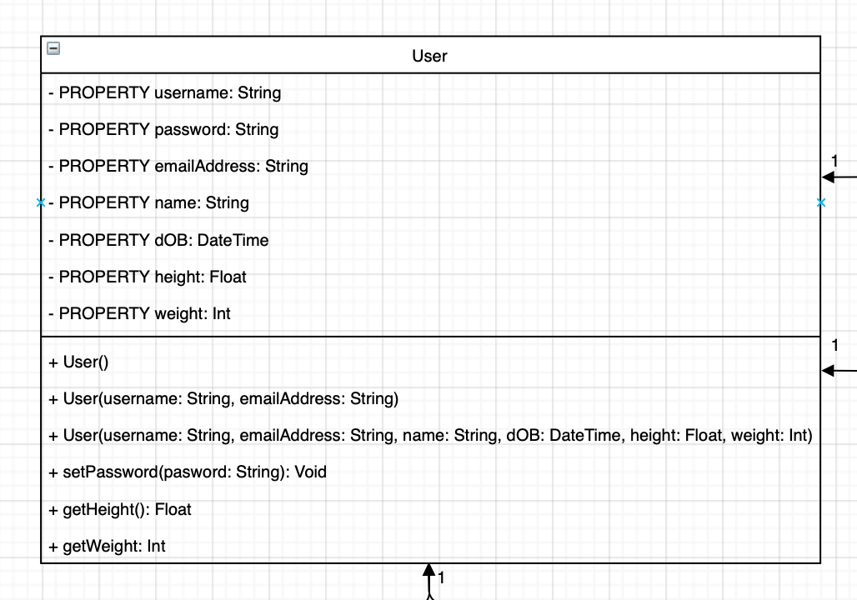
Startup/Profile Creation
Sign up or login. If the user chooses sign up, they will need a unique username, email, and password combination.
Checks with the database for combination.
Once valid entries, they will enter other properties needed for account, a User object will be created and it will be stored in the database (UserTable).
This will be the new opening screen for the application.
This page will display the users health data, all workouts/workout information, statistics, and rest days.

Slide 4
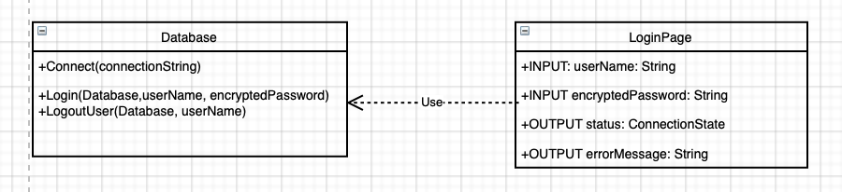
Log In
LoginPage​
Enter Username​
Enter Password​
Outputs Error if the login fails​
Sends username and encrypted password to server​
Database​
Connects to the database​
Login/Logout User

Slide 5
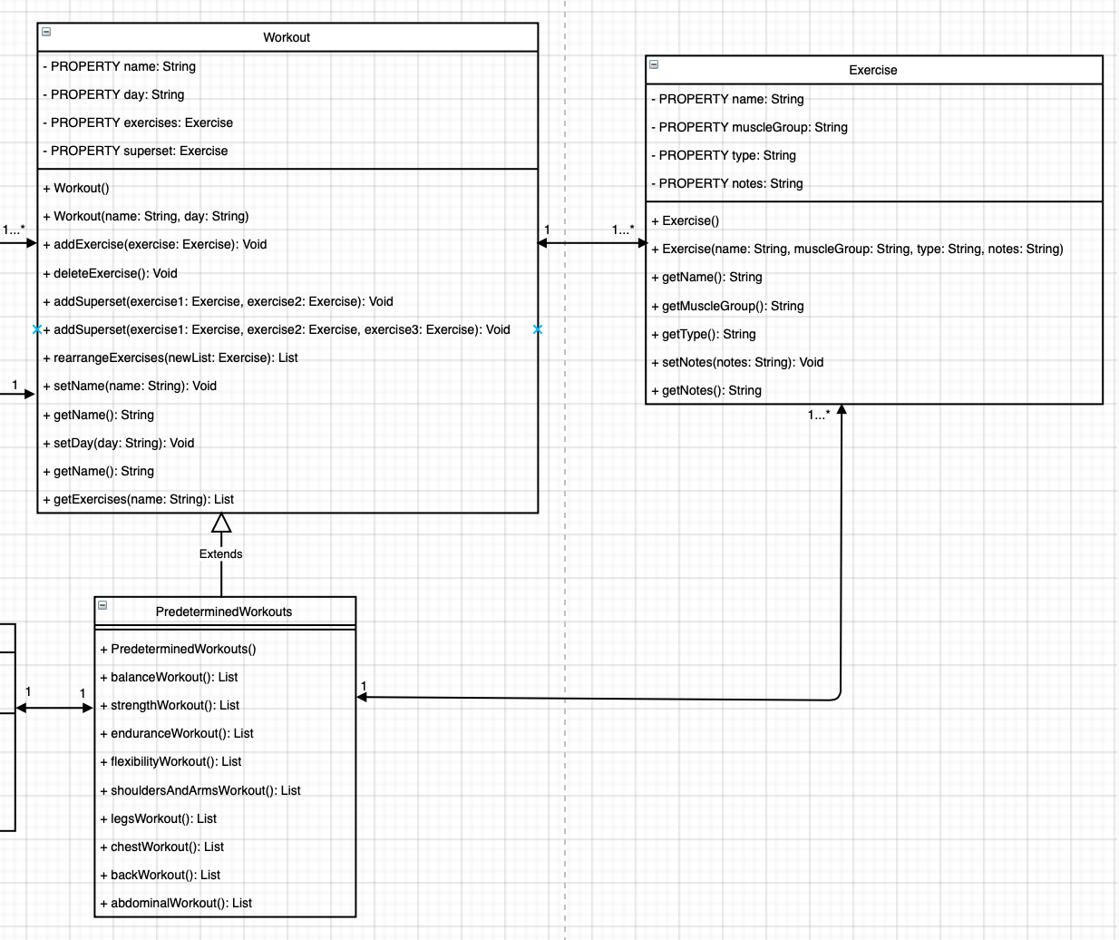
Workout
To add a workout to their profile, the user can choose to create their own or select from predetermined workouts; both are created from a list of Exercise objects with additional properties.
If they choose to create, they will see a screen with muscle groups or types which, when chosen, will show all exercises of that group or type.

Slide 6
Created Workout
User can create supersets or add notes.
Once done, they will need to name the routine and set a day to it, initializing the object and storing it in the SavedWorkouts table; they will return to home screen.
User can edit or delete exercises from choosing to do so on the home screen.
Editing will allow the user to add or remove exercises, rearrange the exercises, create supersets, or alter the day.

Slide 7
Predetermined Workout
Has the same features as a created workout but routines will be hard coded.
Will be stored in the PredeterminedWorkout Table,
The user will be able to add any combination of predetermined and manually created routines to their queue.

Slide 8
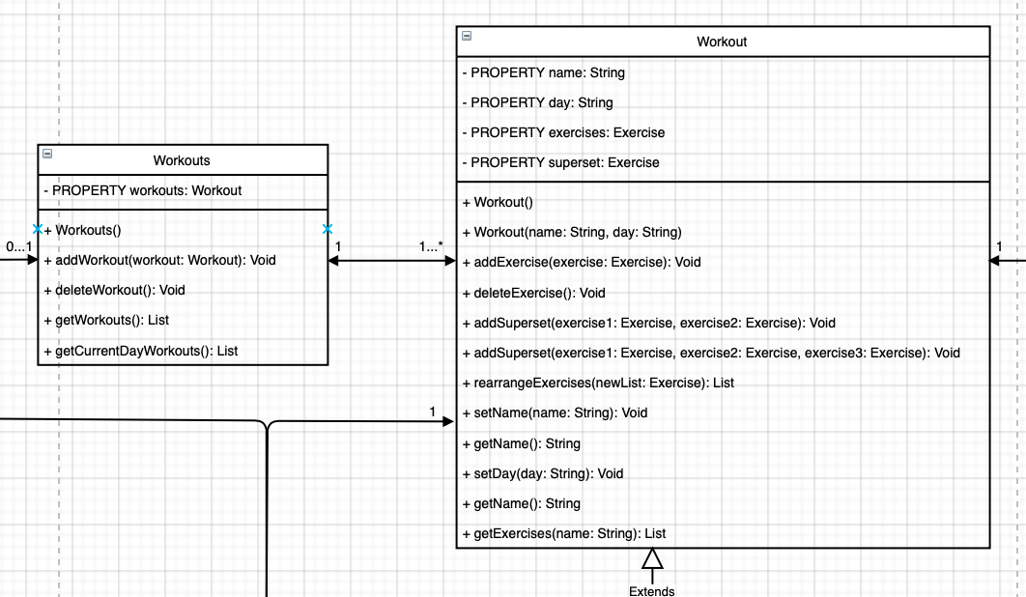
Workouts
On the home screen the user will see the list of workouts they’ve chosen to add to their profile (created and predetermined) on the specified day due to the Workouts object.
By selecting edit workouts from the home screen, they will be shown their Workouts object, a list of Workout[s], and will be able to add new routines at will, as well as delete them.

Slide 9
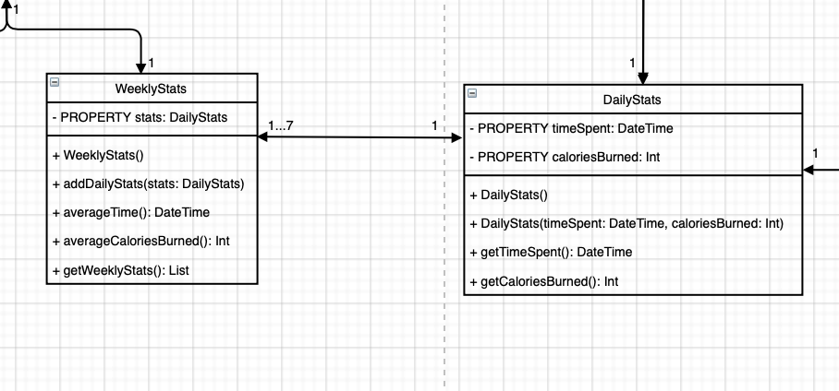
Statistics
The user’s profile will show them both daily and weekly statistics to better track their progress. ​
The DailyStats uses data from the user’s profile and Workout, specifically their time spent active, the type of workout they performed, and their weight, to calculate the calories burned in the workout; each day a workout is performed, this data is taken and stored in the WeeklyStats list.​
The list of daily stats will be averaged each day, viewed in a graph, and stored in the database.

Slide 10
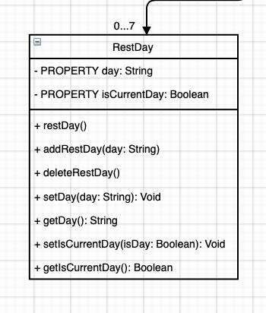
Rest Days
From the home screen, the user will have the ability to add rest days to any day of the week or to the current day.​
The current day option resets each day while the manually selected days will remain until the user chooses to change them.​
Multiple days can be rest days as long as there isn't a routine set to that day; if there is, the user will be unable to set the rest day to that particular day.​
This information will create and initialize a RestDay object that will be stored in the database. ​

Slide 11
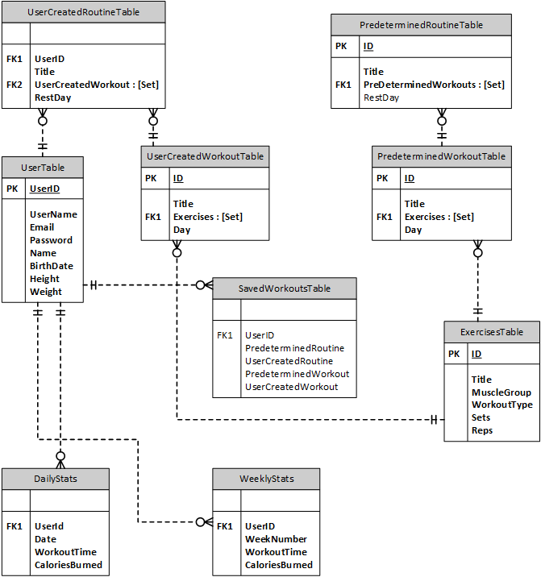
ERD Diagram
User Table - holds information about the user​
Primary Key: UserId​
PredeterminedRoutine Table​
Primary Key: ID​
Foreign Key: PredeterminedWorkouts​
PredeterminedWorkout Table​
Primary Key: ID​
Foreign Key: Exercises ​

Slide 12
ERD Diagram
SavedWorkouts Table​
Foreign Key: UserId​
UserCreatedRoutine Table​
Primary Key: ID​
Foreign Key: UserCreatedWorkout​
UserCreatedWorkout Table​
Primary Key: ID​
Foreign Key: Exercises ​

Slide 13
ERD Diagram
DailyStats Table​
Foreign Key: UserId​
WeeklyStats Table​
Primary Key: UserID​

